Slide 1
Blockit Master Training

Slide 2
Process Orthopaedic, Spine and Cardio Referral Scheduling

Slide 3
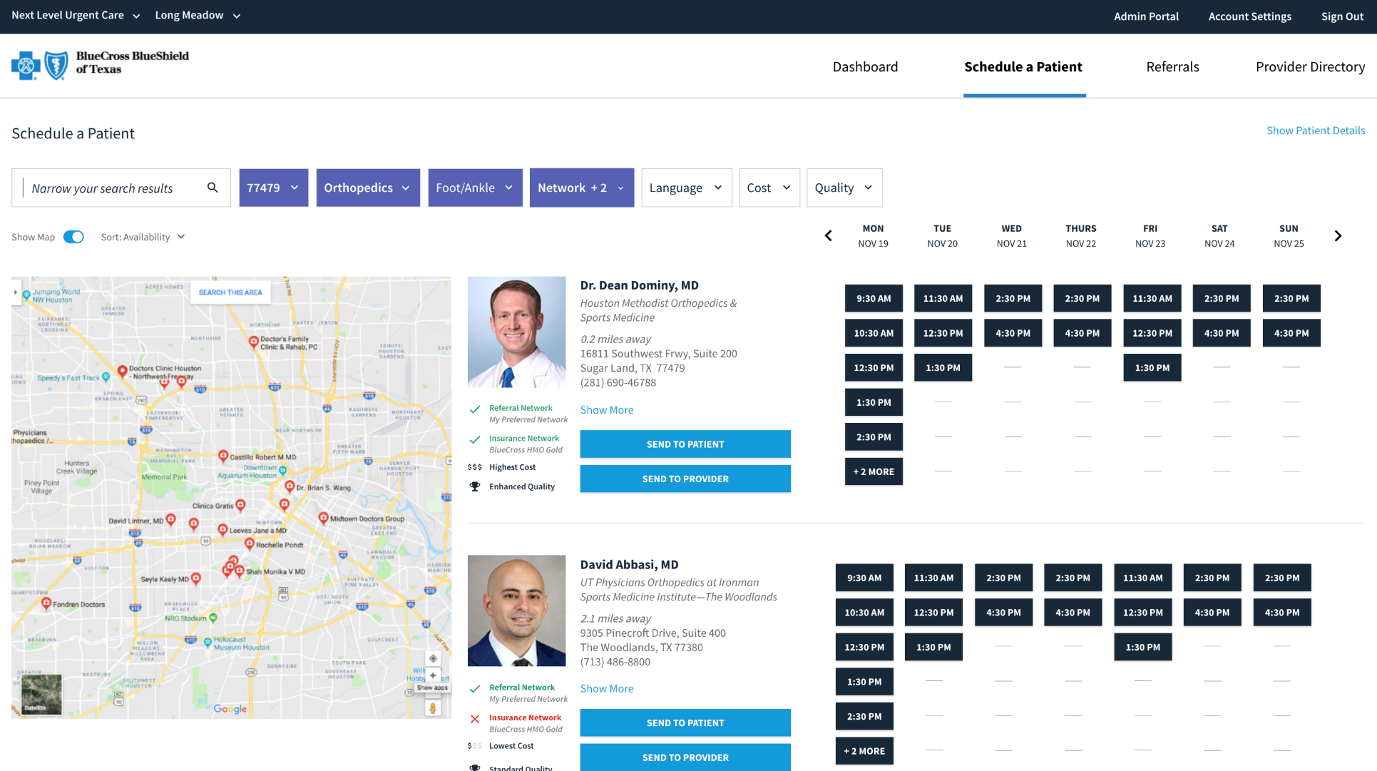
What is Blockit?
Blockit is a simple web-based application that will be added to your facility’s intranet site, easily accessible from any workstation or iPad.
SSO Button will automatically login users that have a profile built in Blockit based on their AD credentials.
Within minutes after the ED Provider referral, staff will be able to schedule the patient’s follow up appointment at bedside.
Notes:
Jason to cover this slide

Slide 4
Blockit Overview
Key Benefits
Booking of patient appointments in real-time at point-of-care (PoCS)
Sending of referrals through the Blockit platform directly to receiving provider’s EMR system
Tracking of patient referral and appointment status in real-time
Insights into referral activity through analytics
Increased patient follow-through with their scheduled appointment

Slide 5
Bedside Navigation Workflow
ER Provider makes specialist referral in Meditech
ED Nurse or Navigator selects patient from the Scheduling Workflow Queue in Blockit
ED Nurse or Navigator coordinates follow up appointment with the referred to specialist at bedside
Patient selects preferred appointment date and time through Blockit
Blockit transmits appointment to referred to specialist’s EMR
Patient attends follow up appointment
7

Slide 6
Follow-Up Navigation Workflow
Patient declines to schedule at bedside or they are referred to a non-participating provider. ED Nurse or Navigator selects Send to Follow Up Queue in Blockit
Follow-Up Appt Scheduler contacts patient and attempts to schedule. If referral is to a non-participating provider and requests scheduling, completes warm hand off to NCCM
Follow-Up Appt Scheduler makes two attempts and documents specific outcomes within Blockit
NCCM completes scheduling of patient using compliant process, as needed
9

Slide 7
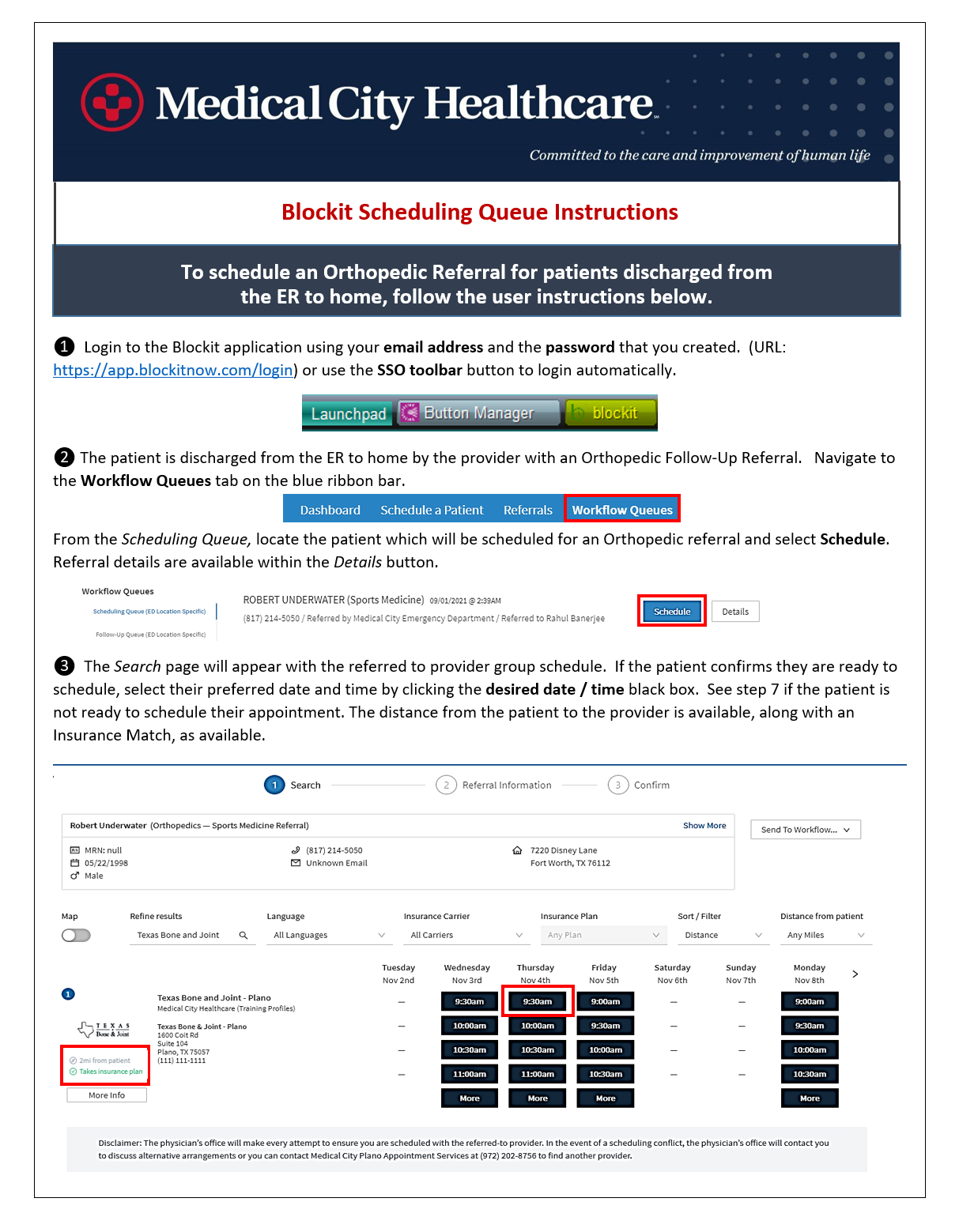
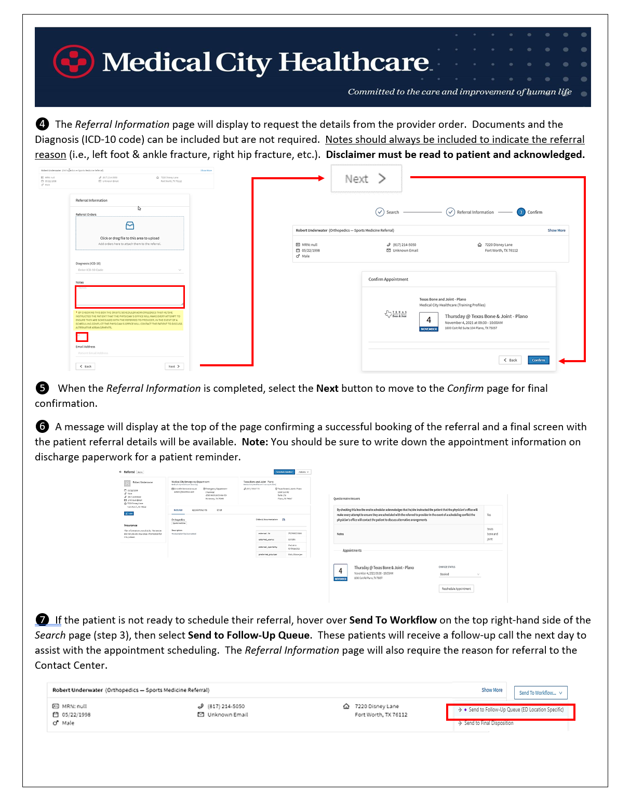
Training Documents / Expectations
80% of the ED Staff training must completed by the Thursday before your facility go-live date
Follow-up Scheduler(s) training must be completed by the Thursday before your facility go-live date

Slide 8
Workflow Blockit ER Scheduling

Slide 9
North Texas – Blockit Workflow
Referral Results Documented
2 attempts during business hours
Make an
appointment
ER / FSER
All Other Targeted Specialty Areas of Focus*
ER Physician makes referral in ScriptRX / Meditech
Ortho Referral?
CRM/NCCM
Monthly
Reporting
No
Unable
to reach
END
Referred to provider receives a notification if they have enrolled in ER referral notification.
Yes
Patient
declines
Referral Populates Blockit Scheduling Queue
Patient can use CRM/NCCM Contact Number in Discharge Instructions to Schedule with Named Provider or Request Referral
Bedside Navigator meets with the patient before they leave the ER to help facilitate Ortho
follow-up using Blockit
Emergency Room Staff
Schedule Pt with Named Specialist using
No
*NTX Pilot Specialties
The following specialties will be deactivated and NOT flow through normal CRM workflow. Orthopaedic Sports Medicine Orthopaedic Surgery Pediatric Orthopaedic Surgery Surgery of the Hand The following specialties will continue to flow through normal CRM workflow. Cardiology (Cardiology, Cardiovascular Disease, EP, etc.) General Surgery Gastroenterology Neurology (Neurology, Neurological Surgery) OB/GYN Urology
**
Onsite Follow-Up Appt. Scheduler reviews Blockit Follow-Up Queue for Unscheduled Referrals ***
For PSG Providers only
Yes
Monthly
Reporting
Patient Booked and sent to Referred Provider EMR
***see next slide for details
Patient Status Sent back to BlockIT
END
Patient Receives Reminder of Scheduled Appt via email from Blockit
Patient Attends Appointment
**Implementation Requirement
Blockit must lock down system to eliminate any changes to the referral made by the referring provider.
Legend:
BlockIT
Navigator
CRM / NCCM
04.27.21

Slide 10
North Texas – Blockit Workflow
Legend:
BlockIT
Navigator
CRM / NCCM
*Referral Hierarchy
Discharging Physician Preference – Navigator Makes Appt., No Disclosure Patient Preference – CRM / Central Scheduling No Preference or Named Specialist Unable to Accommodate. Stark-Compliant Randomization of Physicians on Referral Panel - Call CRM/NCCM for Randomization, Disclosure
Onsite Follow-Up Appt. Scheduler reviews Blockit Follow-Up Queue for Unscheduled Referrals ***
Onsite Follow-Up Appt. Scheduler attempts contact with Unscheduled patients.
No
2 Attempts made during business hours
Was contact made?
END
Workflow
Navigator needs CRM/NCCM to assist with searching and finding a specialist for the patient. Note - NCCM must speak directly to the patient to read the disclaimer, document the disclaimer was read and generate the search. Navigator can use the following methods: Option 1: Call CRM/NCCM and provide key patient demographic information and patient preferences and then put the patient on the phone (3-way phone call or 2-way phone call). Option 2: Provide CRM/NCCM phone number to patient and ask that they call the contact center. Out of scope referral scenarios for NCCM ER Follow-Up: patients who are using auto-insurance (i.e. in the instances of motor vehicle accidents) patients who are using veterans insurance or workers comp patients who are not discharged to home patients with missing key data such as a valid phone number, the referring provider, referred to specialty, etc.
Yes
Is Referred Provider Schedule available in Blockit?
Yes
Does patient
decline
Referral to Named Provider?
No
Navigator completes appointment in Blockit.
Patient Booked and sent to Referred Provider EMR
Patient Receives Reminder of Scheduled Appt via email from Blockit
Patient Attends
Appointment
Monthly
Reporting
No
Yes
Patient Status Sent back to BlockIT
END
Does patient
decline
Referral?
Does patient
want another referral?
No
END
Yes
END
END
Yes
Referral Results Documented
END
Warm Hand off to CRM/NCCM to schedule with referred specialist or patient preference. Or Patient is provided CRM/NCCM’s phone number.
Make an
appointment
No
CRM/NCCM*
Monthly
Reporting
END
Patient
declines
04.27.21

