Slide 1
Gastric Residual

Slide 2
To Check or not to Check
Gastric residuals will no longer be routinely checked to monitor feeding tolerance nor will they be part of routine patient documentation.
Does a large gastric residual indicate feeding intolerance? No! Gastric residuals are expected in preterm infants- they are physiologic not pathologic. The disorganized and slow motility of premature infants contributes to delayed gastric emptying and increased gastric residuals.

Slide 3
Does it matter if I check residuals?
Checking gastric residuals affects nutritional management decisions and may unnecessarily discontinue or delay feeding advancement. Gastric residuals do not always indicate feeding intolerance or an increased risk for NEC.
Consequences of delayed feeding advancement
Prolongs time to reach full enteral feeds
Increases number of days on TPN
Increases risk of EUGR

Slide 4
Thorough abdominal assessment
Is the abdomen tender of distended?
Do I see visible loops?
Do I hear good bowel tones?
What color is the abdomen?
Is it pale, have an area that is dusky or have red streaks?
Is there emesis present? What color is it?
What is the color and consistency of the stool?

Slide 5
Evidence
Evidence support the change to not checking for residuals. Not only is there no conclusive evidence that evaluating gastric residuals “improve care or prevents complications such as sepsis, necrotizing enterocolitis or feeding intolerance,” evaluating gastric residuals can delay the time to reach full enteral feeds and therefore increase the “length of time central access is required.” Torazza explained that the “time to reach feedings of 150 ml/kg/day… occurred nearly 6 days earlier” in the control group that did not have gastric residuals evaluated. In addition, the “length of time central access was required was nearly a week shorter” in this same group. In the study, they “found no evidence that the routine evaluation of gastric residual helps prevent complications such as NEC or feeding intolerance,”

Slide 6
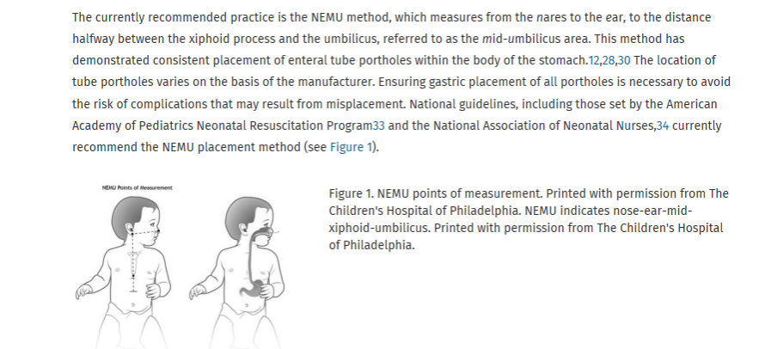
Evidence based practice for the insertion of OG/NG tube

Slide 7
OGT sizing
Patients less than 1500 g will require a 5 fr, 6.5 fr or 8 fr SILICONE feeding tube
Patients greater than 1500 g may have 5, 6.5 or 8 fr POLYURETHANE feeding tube
Any patient with an 8 fr feeing tube under 1500 g must have an order for that sized feeding tube.

