Slide 1

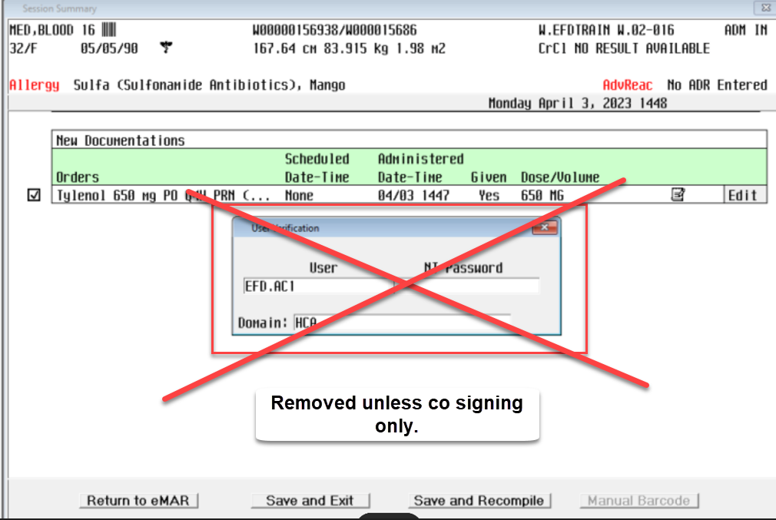

Removal of BCMA Authentication
Go-live: April 19, 2023
Background:
The current state of med pass allows duplicate authentication while the nurse is already logged into a Meditech session. This extra step is unnecessary and has no inherent value except when co-signing.
This change will remove such unnecessary duplication.
What this means to you…
  For regular med passes not requiring co-signature, you will no longer need to enter your mnemonic and password.
  The co-signer will continue to enter her credentials upon cosigning medications.
  Ensure you are following information security policy at all times. Ensure you are logging out/ locking the screen when walking away from your computer.

